Slide 1
City Hopper
CAR POOLING APP
Developer : Karanjot Singh

Slide 2
Project Description
City Hopper is a project designed to make easier to travel between cities. With an affordable price for the customers who uses the app and extra money for drivers who can post their trips on the app.
City Hopper will change the way we think about long distance travel. Our app will be designed ground up to have cross-platform support, so that our users can use any of their preferred platform. We are planning to implement an interactive map to help our users with navigation and give our user with real-time information about rider and driver location. The app will also include build in chat function so that drivers and riders can communicate with each other about trip information or relevant questions.

Slide 3
Highlights of Project Vision
Carpooling: An arrangement between people to make a regular journey in a single vehicle, typically with each person taking turns to drive the others.
Driver: A person willing to offer his car and space to take people from City A to City B.
Rider: A person willing to travel with a driver to go from City A to City B.

Slide 4
Highlights of Project Vision
Business opportunity:
A lot of people are travelling long distances every day between cities. And because of this high demand long distance carpooling industry has been created. But this industry is still in its infancy, people still posts and receives information about carpooling advertisement in local classified websites, where safety and security may be compromised. Our goal is to bridge the between drivers and riders.

Slide 5
High-Level Requirements
Making intercity travel cheaper, and reliable: This is the core of our idea. That is to connect people between different cities easier, faster and cheaper.
Trip info with details : Driver will post trip information that will include the cities he is going to and from and also the date. He will further post pictures of his car, trip cost per person and the amount of person and luggage his car can handle.
External Lib / Resources: These include other entities and third-party apps that are not property of City-Hopper. E.g. Google resources such as maps.

Slide 6
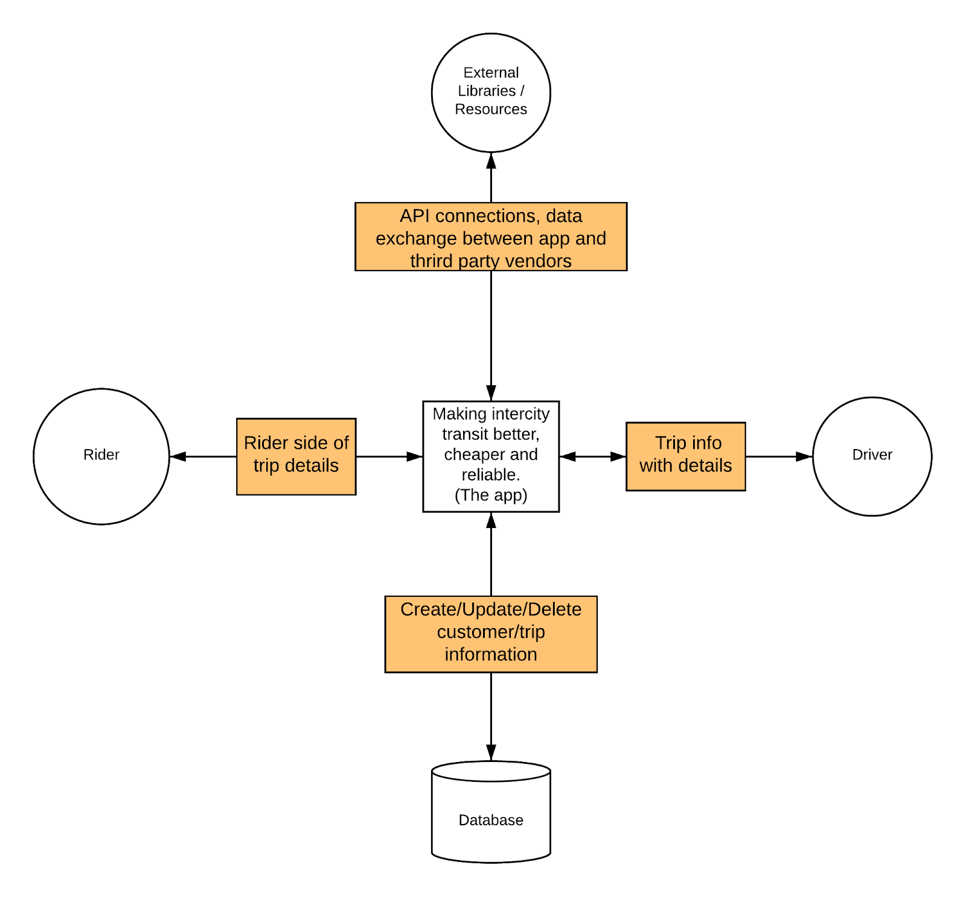
High-Level Requirements

Slide 7
High-Level Requirements
External Entity | Description
Rider | A person looking to travel from city A to city B
Driver | An individual offering to take person(s) across cities for a reasonable amount
External Lib / Resources | These include other entities and third-party apps that are not property of City-Hopper. E.g. Google resources such as maps.
Database | The data warehouse to store every activity on the server. Can be local or hosted on other service providers such as AWS.

Slide 8
Project Plan, Team Charter
Assumptions
The following assumptions were made in preparing the Project Plan:
- Members are willing to learn the required resources.
- All stakeholders will follow the plan.
- Developers will abide by rules plotted by the team lead.
- Project plan may change frequently according to advisors and owner’s opinion.
- Failure to adapt to changes in adequate time will lead to project delays

Slide 9
Project Plan, Team Charter
Dependencies
The following are the internal and external dependencies that will have to be acknowledged and addressed;
Internal | External
Project Planning Team Meeting UI design Gathering System Requirement Project Development | Budget Governmental Laws External Development Packages Web Hosting Plan changes by the owner

Slide 10
Project Plan, Team Charter
Deliverables:
1- Interactive and user-friendly interface
2- Driver/Rider profile creation
3- Driver/user rating system
4- Navigation system

Slide 11
Project Plan, Team Charter
Software Development Life Cycle:
-Planning
-Defining
-Design
-Build
-Testing
-Deployment

Slide 12
Project Plan, Team Charter
Risk Management
1-Adversarial Threat: Hackers can attack to get user password and personal information
2-Accidental: User typed something wrong and break the system
3- Project version: Project version can be compromised if people that work in the project does not have a good understanding in tools to keep track the version of the project

